Slide 1
Building and Deploying Web APPS using Java & Spring
BY
TARUN SARPANJERI
NEELESH SALADI
BHASKAR REDDY MINUPURI
SAI ROHITH GORLA

Slide 2




Bhaskar Reddy Minupuri
https://github.com/Bhaskar2909
Sai Rohith Gorla
https://github.com/SaiGorla
Neelesh Saladi
https://github.com/neeleshsaladi
Tarun Sarpanjeri
https://github.com/dexterstr

Slide 3
Spring framework in Java
The Spring Framework is a Java platform that provides us the comprehensive infrastructure support for developing Java applications. Spring handles the infrastructure so you can focus on your application.
Spring framework was designed to simplify Java EE development and make developers more productive. Spring makes use of Inversion of Control and Dependency Injection to promote good software coding practices and speed up development time.
Java-based configuration option helps you to write most of your Spring configuration without XML but with the aid of only a few Java-based annotations.

Slide 4
Spring Framework provides
Application context and dependency injection
Data access
Spring MVC

Slide 5
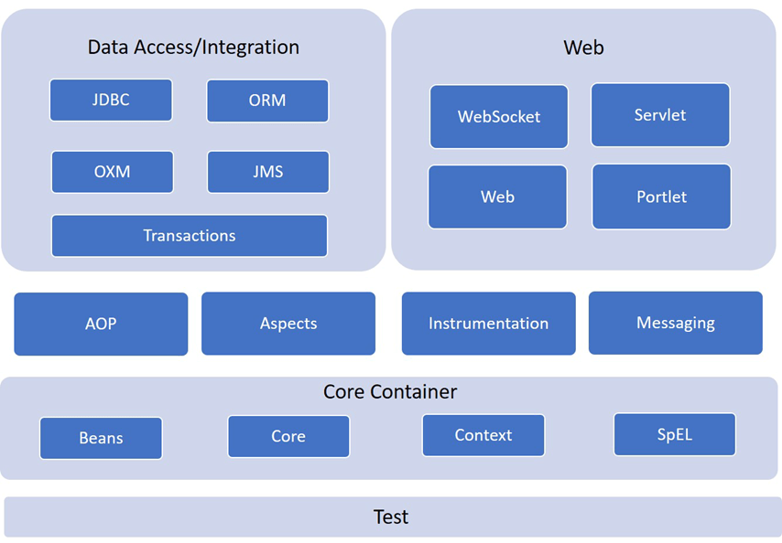
Spring Framework Architecture

Slide 6
REST API
REST is a Representational state transfer is a software architectural style that defines a set of constraints to be used for creating Web services.
A RESTful API is an application program interface (API) that uses HTTP requests to GET, PUT, POST and DELETE data. ... REST technology is generally preferred to the more robust Simple Object Access Protocol (SOAP) technology because REST leverages less bandwidth, making it more suitable for internet usage.
A REST API works in a similar way. ... It is a set of rules that developers follow when they create their API. One of these rules states that you should be able to get a piece of data (called a resource) when you link to a specific URL. Each URL is called a request while the data sent back to you is called a response.

Slide 7
Guiding Principles of REST
Like any other architectural style, REST also does have it’s own 6 guiding constraints which must be satisfied if an interface needs to be referred as RESTful. These principles are listed below.
Client–server
Stateless
Cacheable
Uniform interface
Layered system
Code on demand

Slide 8
Resource
The key abstraction of information in REST is a resource. Any information that can be named can be a resource: a document or image, a temporal service, a collection of other resources, a non-virtual object (e.g. a person), and so on. REST uses a resource identifier to identify the particular resource involved in an interaction between components.
Another important thing associated with REST is resource methods to be used to perform the desired transition. A large number of people wrongly relate resource methods to HTTP GET/PUT/POST/DELETE methods.

Slide 9
Maven
Apache Maven is a software project management and comprehension tool.
Maven is a build automation tool used primarily for Java projects. It can also be used to build and manage projects written in C#, Ruby, Scala, and other languages.
Maven addresses two aspects of building software: how software is built, and its dependencies. ... NET framework exists and is maintained, and a C/C++ native plugin is maintained for Maven 2.
Maven is used to manage a project's build from a central piece of information. Maven is not mandatory for spring mvc application development.

Slide 10
Spring Boot
Spring Boot makes it easy to create stand-alone, production-grade Spring based Applications that you can "just run".
We take an opinionated view of the Spring platform and third-party libraries Most Spring Boot applications need minimal Spring configuration.
Spring boot is tool which lets us create spring based application

Slide 11
Features
Create stand-alone Spring applications
Embed Tomcat, Jetty or Undertow directly (no need to deploy WAR files)
Provide opinionated 'starter' dependencies to simplify your build configuration
Automatically configure Spring and 3rd party libraries whenever possible
Provide production-ready features such as metrics, health checks, and externalized configuration
Absolutely no code generation and no requirement for XML configuration

Slide 12
POM.xml
POM (Project Object Model). The pom. xml file contains information of project and configuration information for the maven to build the project such as dependencies, build directory, source directory, test source directory, plugin, goals etc. Maven reads the pom. xml file, then executes the goal.
A Project Object Model or POM is the fundamental unit of work in Maven. It has the details used by Maven to build the project. It contains default values for most projects.
It is placed at the root folder of the project.

Slide 13
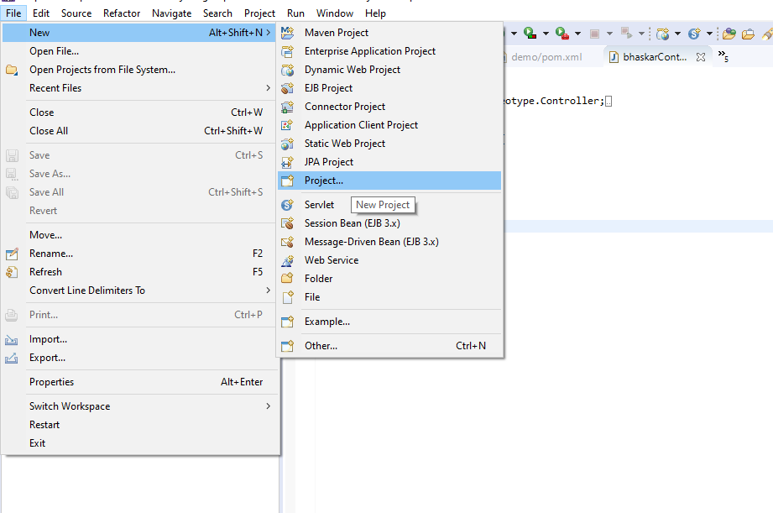

Slide 14
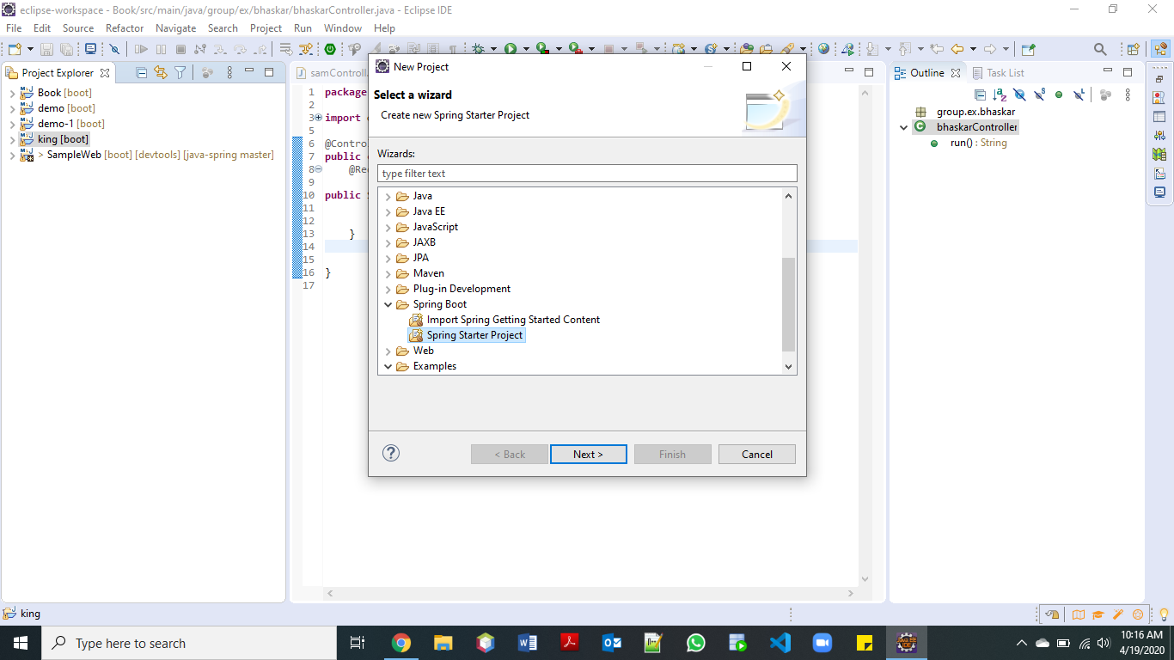

Slide 15
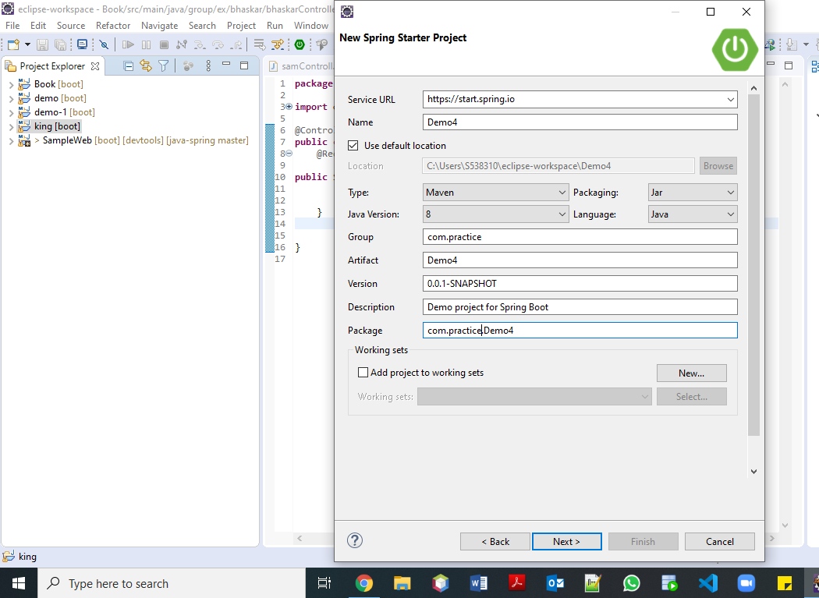

Slide 16
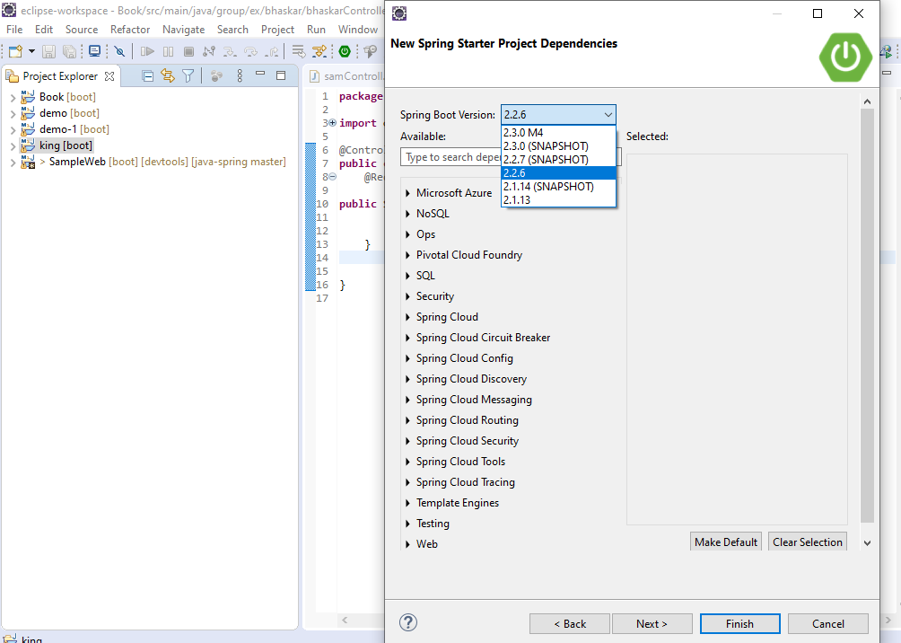

Slide 17
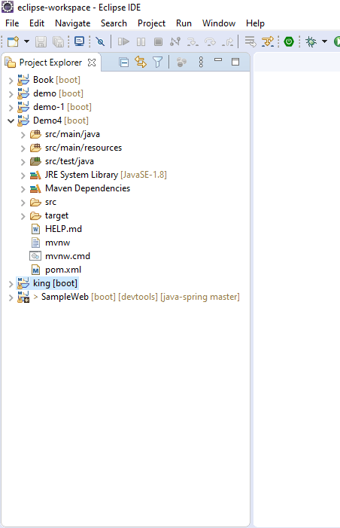

Slide 18
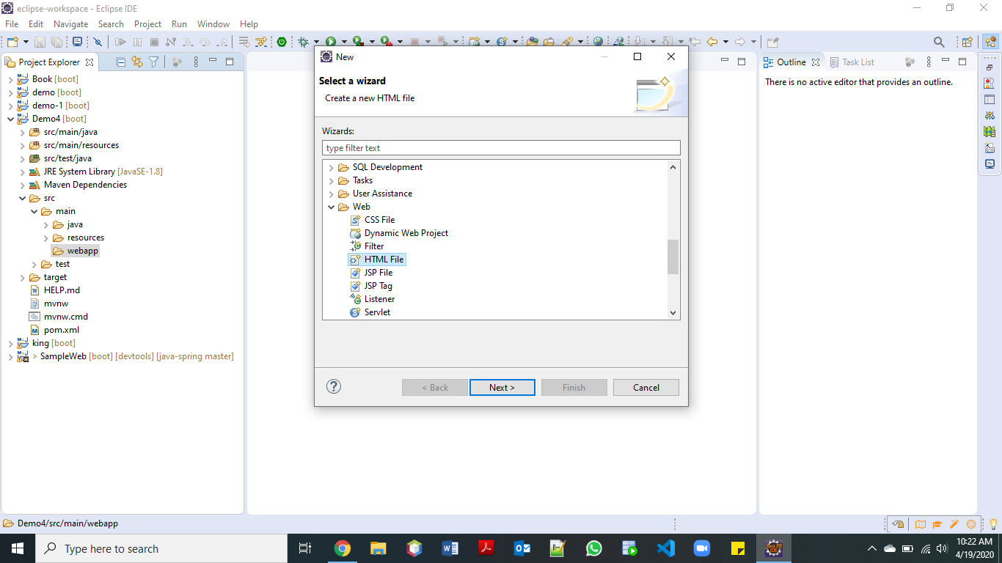

Slide 19
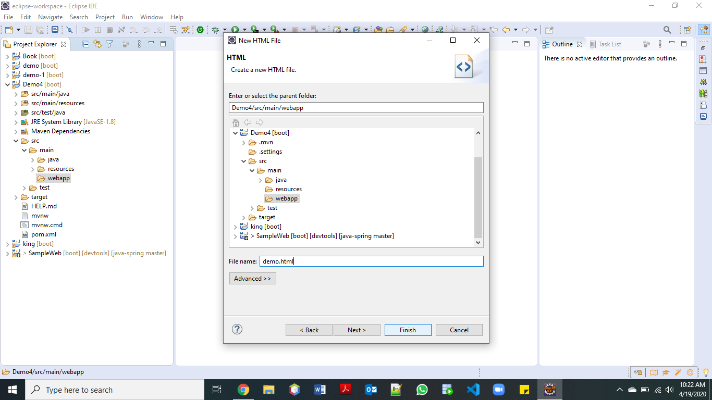

Slide 20
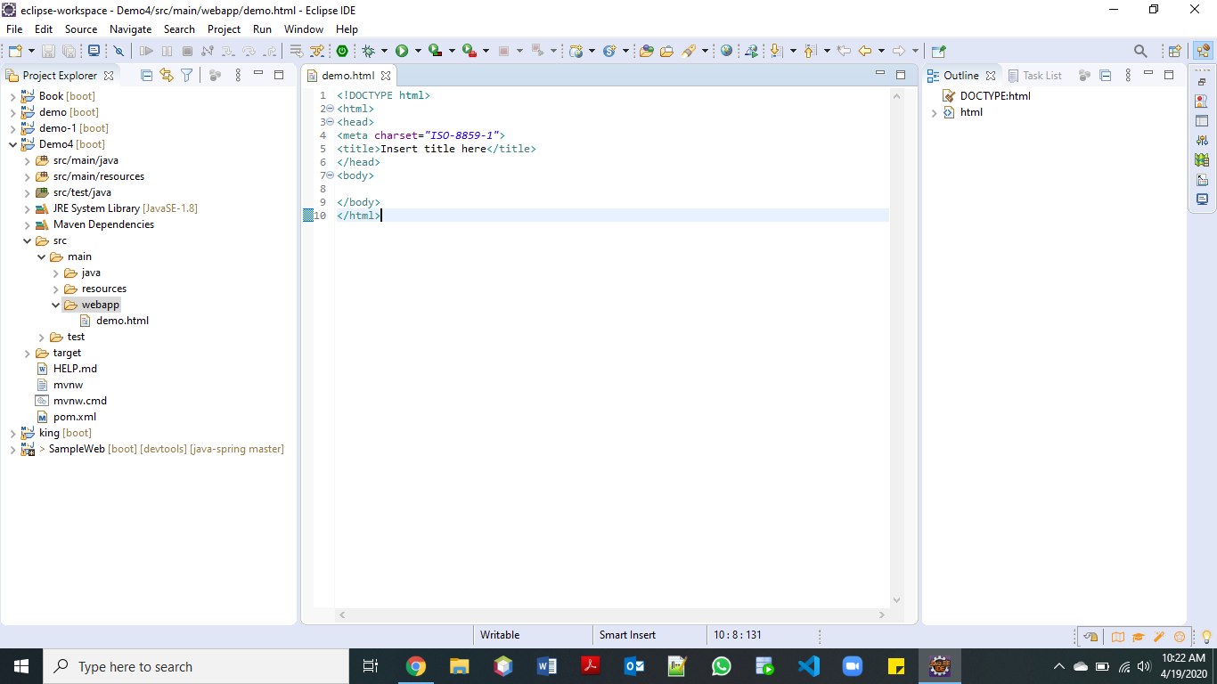

Slide 21
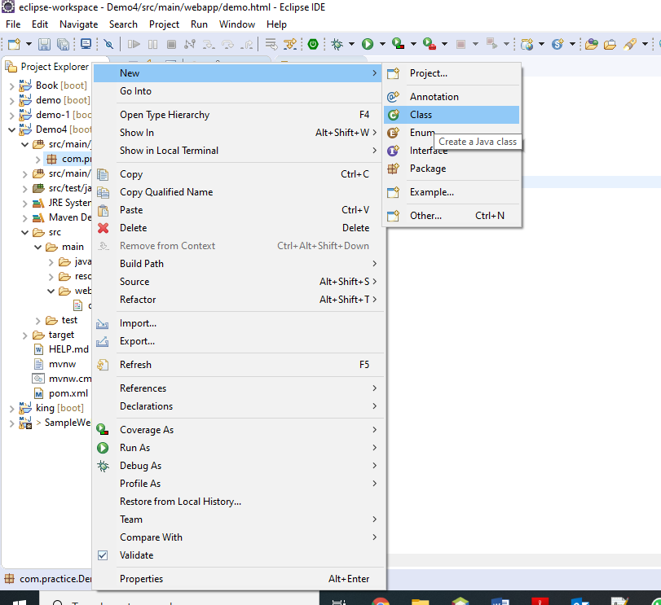

Slide 22
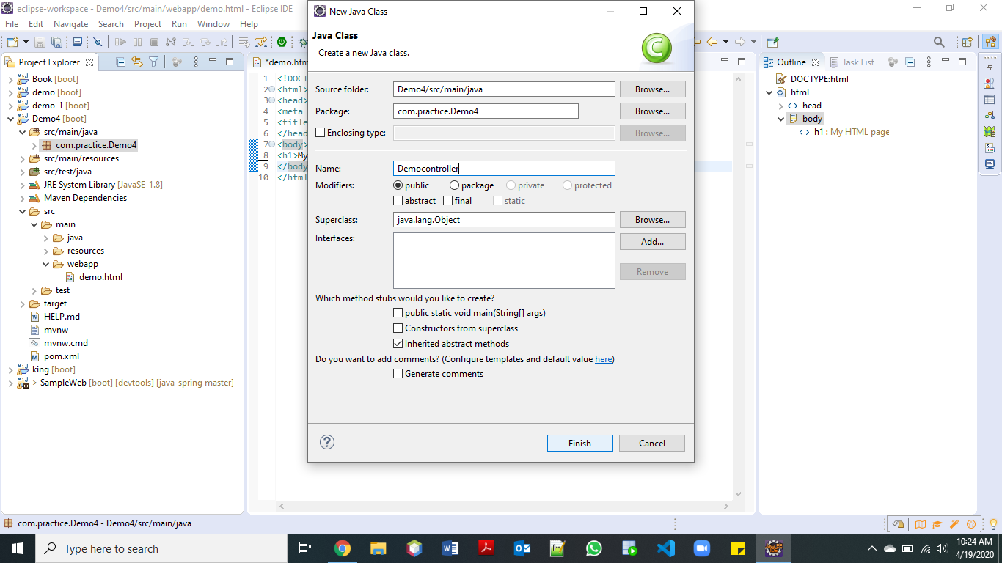

Slide 23
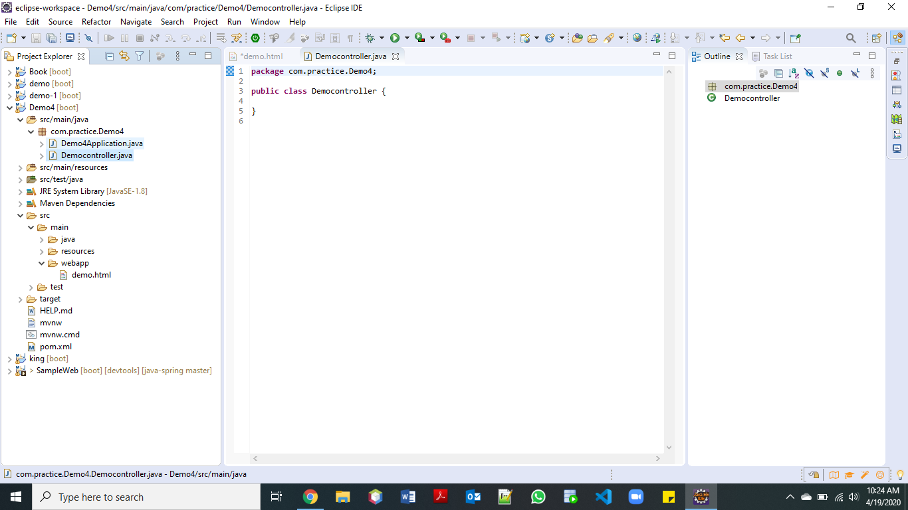

Slide 24
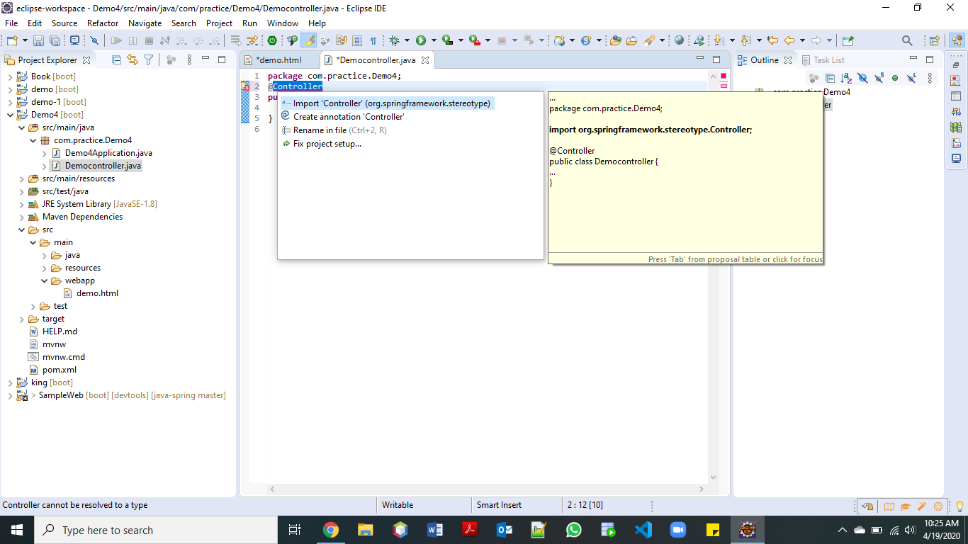

Slide 25
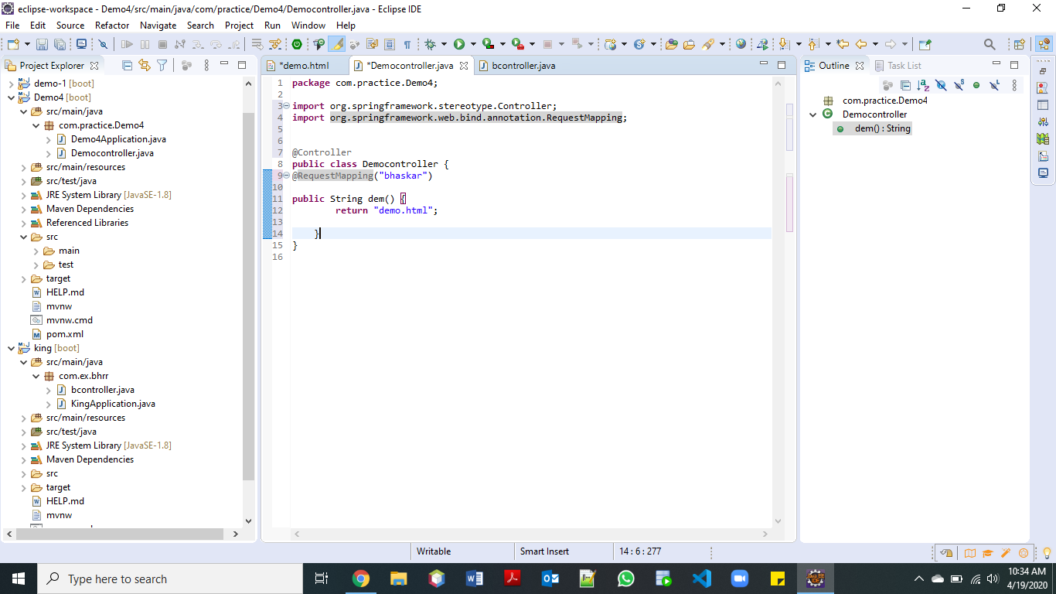

Slide 26
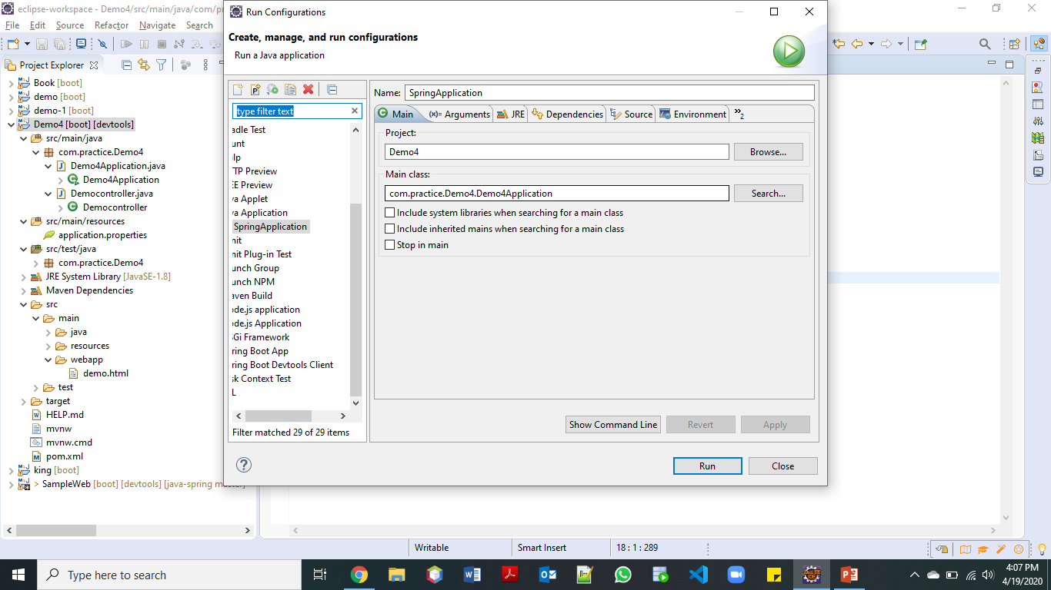

Slide 27
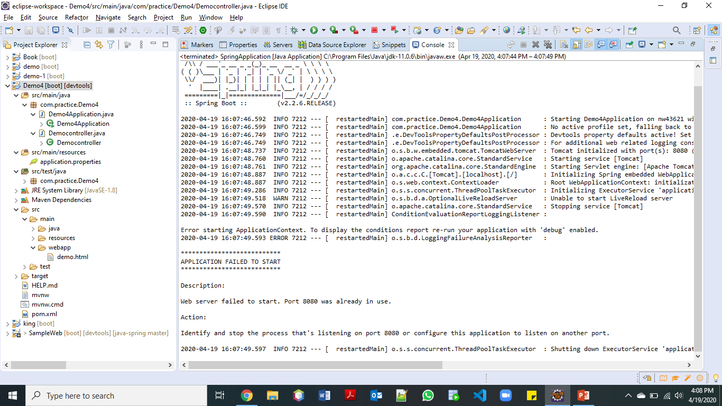

Slide 28
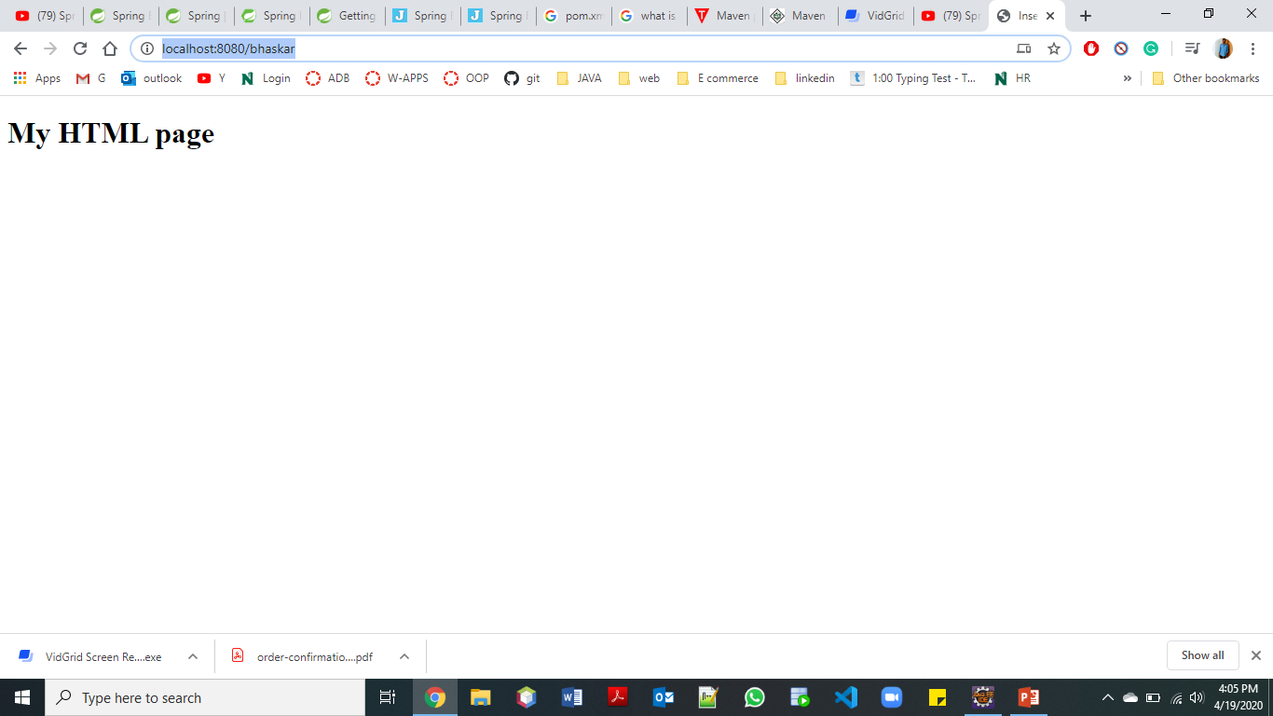

Slide 29
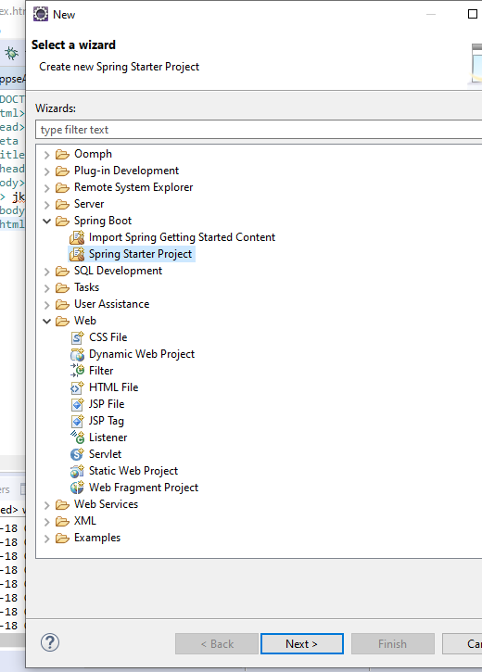
Creating a project and Application in eclipse
For doing a java application we need to create a spring framework project in which we select Spring starter project from Spring Boot.

Slide 30
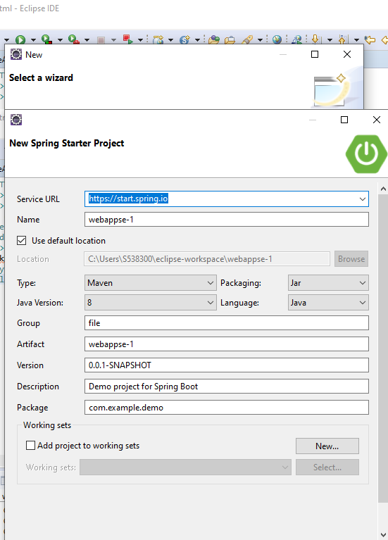
Service URL It is a simple client server architecture which various UI clients such as Spring Boot CLI , IDE or official web UI talk to the same backend HTTP API that actually generates the spring starter project. is the spring initialization
Name of the group.
Package name and the group name have to be same.

Slide 31
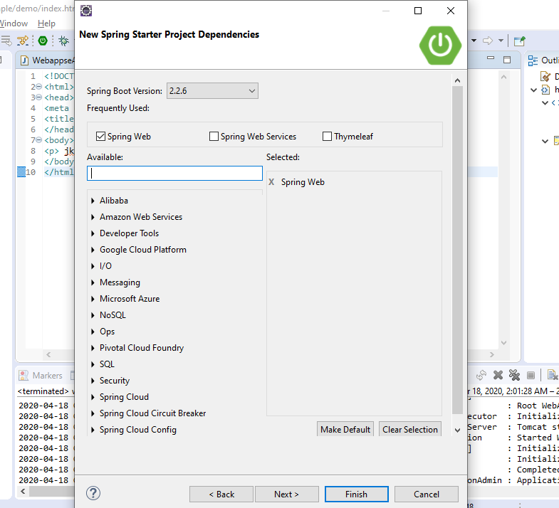
In this we select the dependency for the spring boot project for this we have to add spring web.
It is the implementation of Spring MVC.

Slide 32
working

Slide 33
Web controller
Web API Controller. ... Web API Controller is similar to ASP.NET MVC controller. It handles incoming HTTP requests and send response back to the caller. Web API controller is a class which can be created under the Controllers folder or any other folder under your project's root folder.

Slide 34
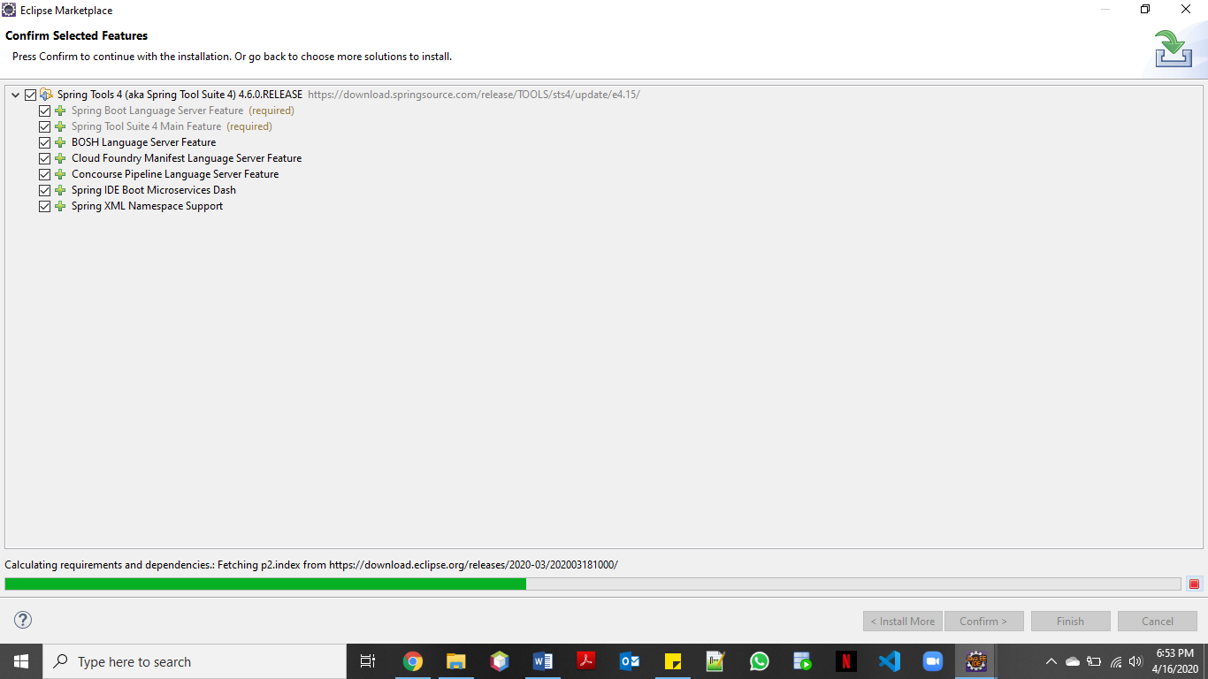
Installing Spring boot in eclipse

Slide 35
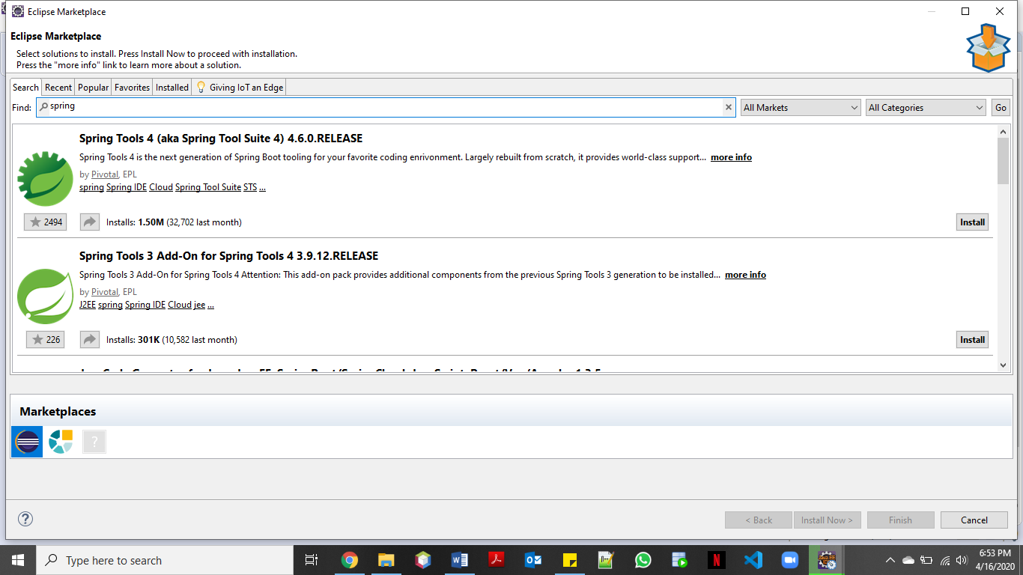

Slide 36
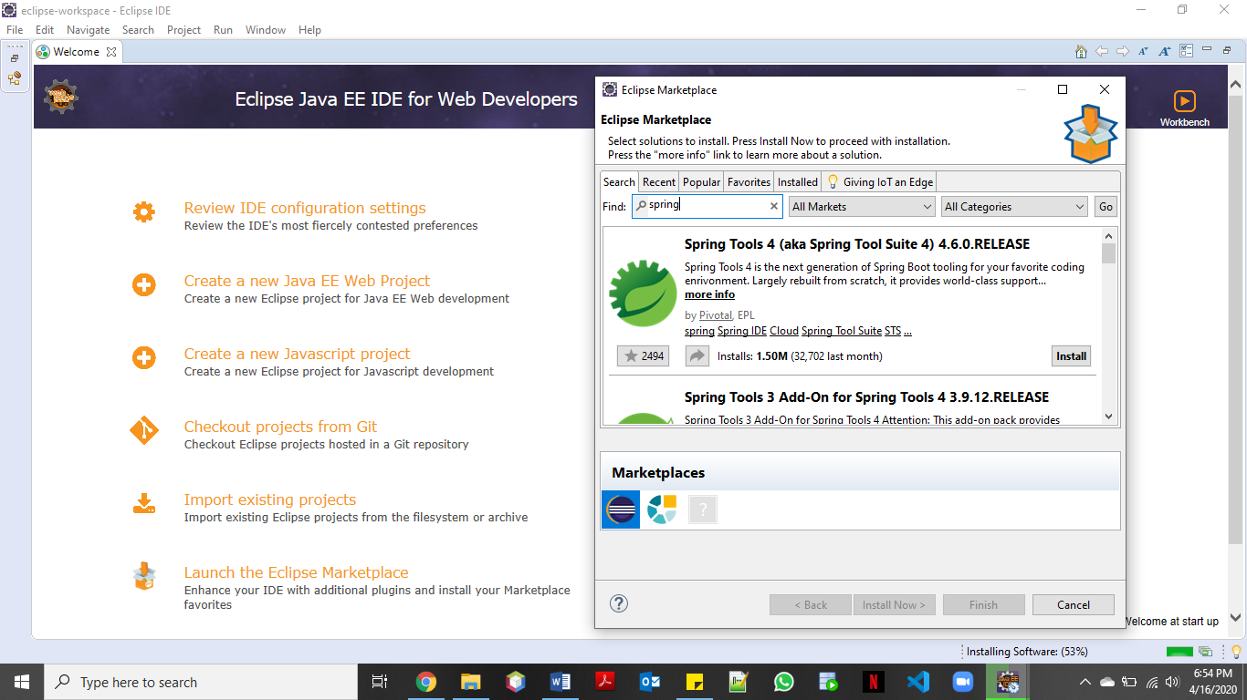

Slide 37
Advantages and uses
Spring provides a lightweight container that can be activated without using web server or application server software.
Spring framework provides generic Transaction Management layer which can be used with or without J2EE(JEE) environment.
Spring Container can be used to develop and run test cases outside enterprise container which makes testing much easier.
Spring framework is an open source application framework and inversion of control container for the Java platform.

Slide 38
conclusion
In this project we are using spring application . So we can create
We have Successfully run our application in Spring boot using REST services
With the help of tomcat server we have hosted it locally and were able to display our web page.

Slide 39
References

